Slide 1

VoxPop Worldwide Inc.
OTC:VOXI
Music 3.0: A Digital Management Holding Company
L. Joshua Eikov, CEO Direct:570.517.1613 josh.eikov@voxpopworldwide.com

Slide 2
Disclaimer
Not an Offer to Purchase or Sell Securities. This overview is for informational purposes and is not an offer to sell or a solicitation of an offer to buy any securities in VoxPop Worldwide Inc. (OTC:VOXI), and may not be relied upon in connection with the purchase or sale of any security. Interests in the Company, if offered, will only be available to parties who are “accredited investors” (as defined in Rule 501 promulgated pursuant to the Securities Act of 1933, as amended) and who are interested in investing in the Company on their own behalf. Any offering or solicitation will be made only to qualified prospective investors pursuant to a confidential offering memorandum, and the subscription documents, all of which should be read in their entirety. Prospective Investors are cautioned to seek advice and counsel from their professional advisers before investing in any security.

Slide 3
About
VoxPop is a public digital media holding company that is amassing a portfolio of products and services used to enhance brands and create selling opportunities for their customers using music and multimedia.
Our customers are corporations and their brands looking for new media enhancement, artists and musicians looking for exposure and digital asset managers looking for new opportunities.
Our solutions include the VoxPop Radio Network, Cordio branded internet radio, TagMango, KoolStart and MediaPal.
Our holdings include investment and ownership in: Song Circle, BETA Records, DYMPOL and 440 Artist Alignment.
Creating A Simple Solution for Music and Digital Media Distribution

Slide 4

Mission
To capitalize on the consolidation of the independent music and entertainment market through selective acquisition of best of breed candidates.
To prosper in this new digital media economy, we must support a new ecosystem built on giving the users easy, cheap, and unfettered access to content. These Digital Natives are much more likely to first opt-in to a comprehensive digital service (yes, including wireless), and only then buy a physical product. – www.mediafuturist.com

Slide 5
Vision
There is serious fragmentation within the DIY (Do It Yourself) segment of the music industry. With a conservative estimate of at least 500 websites that would be considered as major hubs the industry is sure to have saturation very quickly. Digital Music News reported on 6-29-11 that there will be a Darwin effect within the industry which creates an opportunity for VoxPop to capitalize on.
Entrepreneurial artists have more opportunities than ever to make it without the backing of a label and so many more ways to make money than in the past. The advent of the Internet has produced new sites and services that allow artists to get discovered, fund, produce, and market a CD, online and off; they can find their fans, set up a tour, sell merchandise and license their work. Consumers can find all types of music online and compare their tastes with others. They can stream for free, sample indefinitely, and communicate with other fans and artists.
According to research firm Ovum Digital music revenues will top $20 billion in 2015 with 30% of that being independent.

Slide 6
Operating Groups
Radio
VoxPop uses internet radio to create a unique marketing experience that encapsulates their clients branding and selling propositions and then delivers them on a platform of programmed content tailored to genre and demographic mix.
Digital Solutions
VoxPop digital solutions is the group responsible for the repurpose of client media into usable and monetizable assets for sale via mobile or web. Products include: Pay per View, ringtone, ringback, and mobisode based products.
Digital Solutions also handles all social monetization through the use of our MediaPal product and the Visitor.

Slide 7


Radio Products
VoxPop Radio Network and the VoxBox Tunes Application
  Top 20 markets
  Mix of independent and commercial music
  Local market reach- news, weather, sports
  Internet and mobile based
VoxPop Corido
  Corporate branded radio
  Client selected music and content
  Internet and mobile based
Tagmango*
  Music based game driven around independent music
  Product dedicated to discovery and exposure of new music
  Quiz driven game both standalone and Facebook driven
  Listeners accumulate points good for redemption in partner locations
*in development

Slide 8
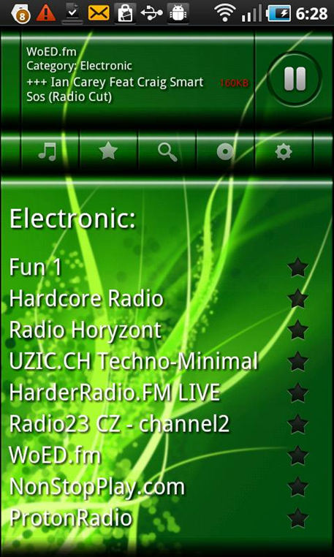
VoxBox Tunes Mobile Application
VoxBox PLAYER / RECORDER & MEDIA SERVER
Listen to VoxPop Radio Network and Cordio stations.
Many SKINS included.
Both Freemium and Subscription models.
Displays ARTIST, SONG and BITRATE
MEDIASERVER: Share MP3,MP4 and JPG Files within same WiFi.
Records everything in advance. If Record is active at the end of a session, the entire session is saved .
VERSION 1.0

Slide 9
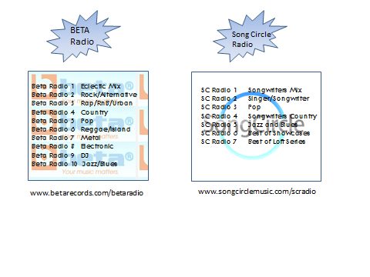
Example Content on VoxBox Tunes

Slide 10
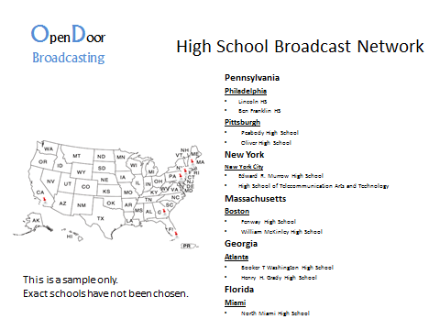
Example Content on VoxBox Tunes

Slide 11


Digital Solutions
GEE Media and Digital Asset Repurpose
  The goal for any digital asset produced is to get as much value out of that asset as possible. Maximizing the value of a digital asset is accomplished by getting as much use (work) and result (return) from that asset.
  To repurpose a digital asset is to utilize the asset (in its original form or modified) for a new and different purpose than which it was originally produced.
  Creation of monetizable products for mobile and internet publishing.

Slide 12

MediaPal and VoxiStore
MediaPal is a service that enables content owners of any size to sell their online content and products anywhere on the Internet and mobility. The MediaPal system makes digital media portable with the ability to sell right from Facebook, MySpace and any number of blog systems. MediaPal also removes the hassles of internet and mobile commerce by housing merchant account, SSL certificate and shopping cart into a one click solution.
VoxiStore incorporate MediaPal as a bolt on to any website turning them into commerce ready locations.

Slide 13
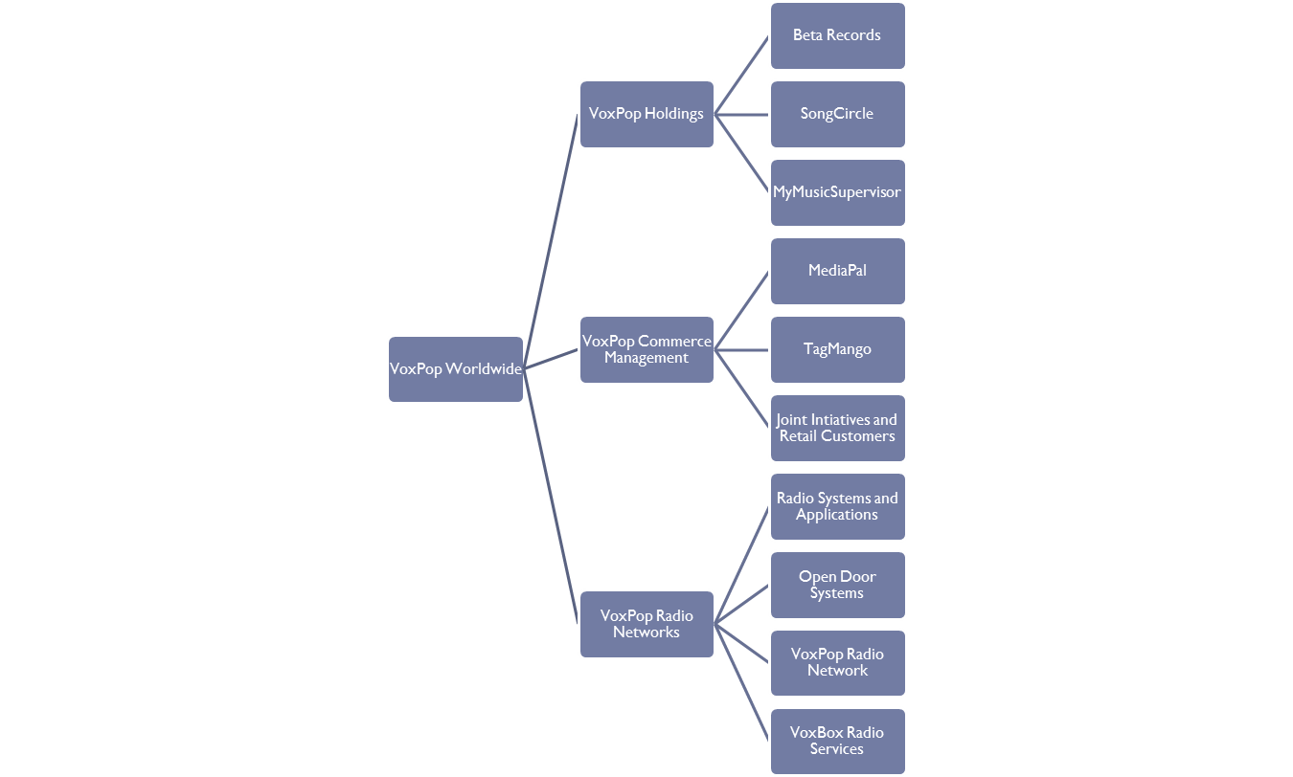
VoxPop Organization View

Slide 14

Strategic Holdings
Beta Records: BETA Records is the first true MUSIC ECOSYSTEM that connects fans with artists in the virtual and real world through its unique content making, moving and monetization business model capable of terrestrial and viral distribution of music and video. BETA Records consists of 4 inter-related content production, hosting and propagation entities: BETA Online, BETA TV, BETA Publishing (Sound Scope) and BETA Radio
VoxPop has an LOI with BETA for 25% equity and an option on the other 75%

Slide 15

Strategic Holdings

Slide 16

Strategic Alliances
Dympol’s e-commerce platform is a superior approach that combines the relevance of something like Google AdWords with the engagement of branded entertainment and the accountability of performance marketing. It catches users as they are ready to spend money by delivering a “personally meaningful” connection with someone, like a celebrity making a direct pitch for a charity.

Slide 17
Management
Phil Quartararo: Chairman
Phil Quartararo has been one of the most successful and respected executives in the music industry for more than 30 years. A genius at promotion and marketing, Phil Q, as he is universally known, started in radio promotion, but quickly rose to the level of President/CEO at both Virgin Records America and Warner Bros. Records.
Quartararo’s first job in the music business came at the age of 19, when he joined the legendary A&M Records as a college rep. He later worked for RCA Records in radio promotion and subsequently moved to Island Records, where, as VP of Promotion, he helped break several superstar acts, including U2.

Slide 18
Management
L. Josh Eikov: Chief Executive Officer
L. Joshua Eikov is a visionary and dynamic leader with a unique blend of strategic finance, business and technological management experiences within entrepreneurial and venture-based private and public corporations.
Josh is the Managing Director of Baron General Capital LLC a merchant banking and corporate consultancy and the General Partner of Laveton House Partners LP a real estate trust. Previous to Baron General Josh helped clients such as Target Email Direct a provider of interactive and email marketing products and services in a turnaround and expansion program as their Interim CTO and he was the Chief Strategist at eBRANDsolutions, a branding and marketing firm that consulted to the Global 1000 on issues of eBusiness, product design, digital marketing and branding and international brand expansion. Josh was the Founder and CEO of i-Titan Communications Networks, a manufacturer and designer of wireless broadband products. Josh served as President and Chief Executive Officer of Digital Consumer Technologies, Inc., a CTI (Computer Telephony Integration) based systems integration Company that was sold to a publicly traded Company in 1998. Josh founded Faceted Information Systems. The Company provided consulting services in information technology and financial information systems including, LAN/WAN systems design to Wall Street and institutional clients. Josh was also instrumental in the design and construction of FIS-Tech Computers.

Slide 19
Management
Jim O’Mahony: Chief Marketing and Branding Officer
Jim O’Mahony started his career within the motor industry in the United Kingdom when the UK actually had a motor industry and has progressed through design, industrial engineering, human resources, operations management and general management positions in a range of industries.
O’Mahony joined Saatchi & Saatchi in 2002 as CEO Australia. He was instrumental in developing a strong management team and winning new business, including Westpac, the biggest win for the agency in over 4 years. As CEO of Saatchi & Saatchi’s Australia office he led the Agency to capture Agency of the Year. Since April 2004, he has taken on an even wider role within the agency network, as Chairman and CEO Asia, Australasia, Europe/Middle East/Africa and Latin America.

Slide 20
Management
Rob Miller, VP Content and Programming
Rob Miller owns and operates community internet radio station PIBCO prior to that he was the Program Director at 93.5 WSBG a Nassau Broadcasting station (a Goldman Sachs investment) for 8 years. Miller studied Broadcast and Radio at East Stroudsburg University and the Connecticut School of Broadcasting.
Lee Morrell, VP Communications
Lee Morrell is a twenty plus year communications industry professional with a background in journalism and public relations. Lee began his career as a general news assignment editor for a top-50 market NBC News affiliate while simultaneously serving as a general news/live performance critic for a top-50 market newspaper. Looking to enter the corporate world, Lee became a top public relations executive for some of the best known public relations and IR agencies in Los Angeles, including Golin/Harris, Edelman Worldwide and CCG IR.

